Slide 1

QUEUE에 대해서
발표 시작 할게용~

Slide 2
그냥 QUEUE

Slide 3
삐뽀방식(FIFO)
add

Slide 4
삐뽀방식(FIFO)

Slide 5
삐뽀방식(FIFO)
poll

Slide 6
삐뽀방식(FIFO)
poll

Slide 7
삐뽀방식(FIFO)

Slide 8
삐뽀방식(FIFO)

Slide 9
삐뽀방식(FIFO)

Slide 10
삐뽀방식(FIFO)
ENQUEUE
queue[rear] <- value;
rear = (rear + 1) % size;
rear
front

Slide 11
삐뽀방식(FIFO)
ENQUEUE
queue[rear] <- value;
rear = (rear + 1) % size;
rear
front

Slide 12
삐뽀방식(FIFO)
2. DEQUEUE
result <- queue[front]
front = (front + 1) % size;
return result
rear
front

Slide 13
삐뽀방식(FIFO)
2. DEQUEUE
result <- queue[front]
front = (front + 1) % size;
return resultD
rear
front

Slide 14
PRIORITY QUEUE

Slide 15
사전지식 heap
최대 힙 : 이진 트리에서, 부모 노드가 자식 노드보다 크다.
최소 힙 : 이진 트리에서, 부모 노드가 자식 노드보다 작다.
예시 : 최대 힙 / 배열

Slide 16
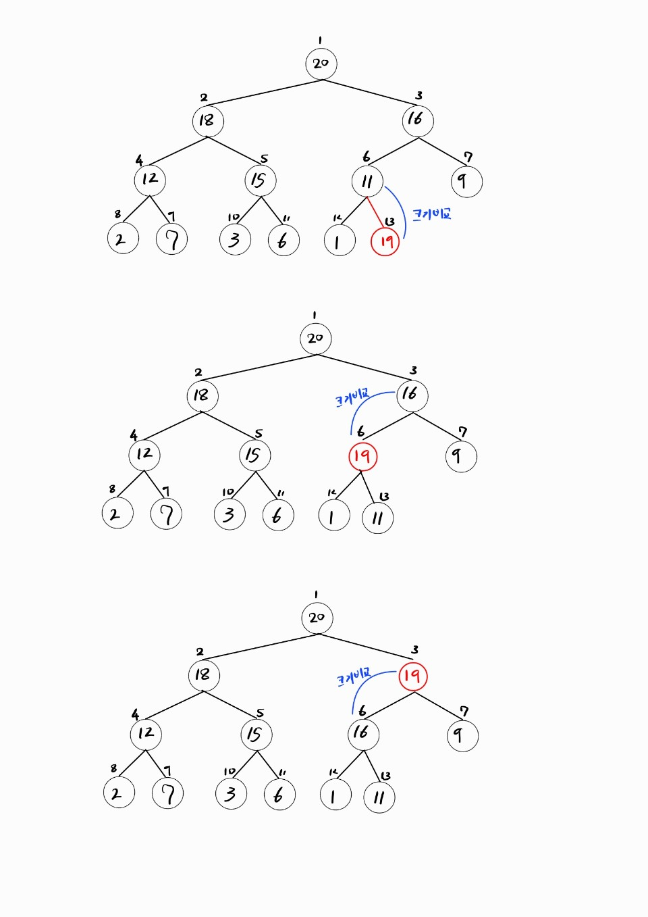
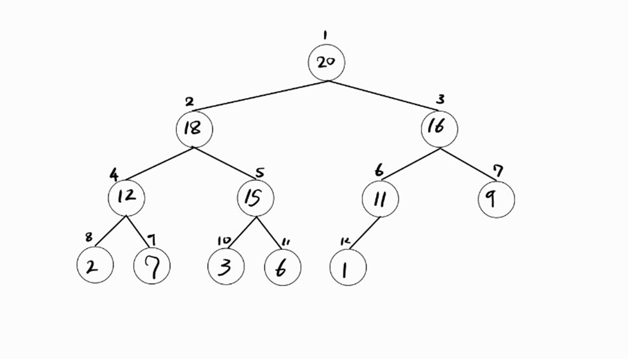
enqueue

Slide 17
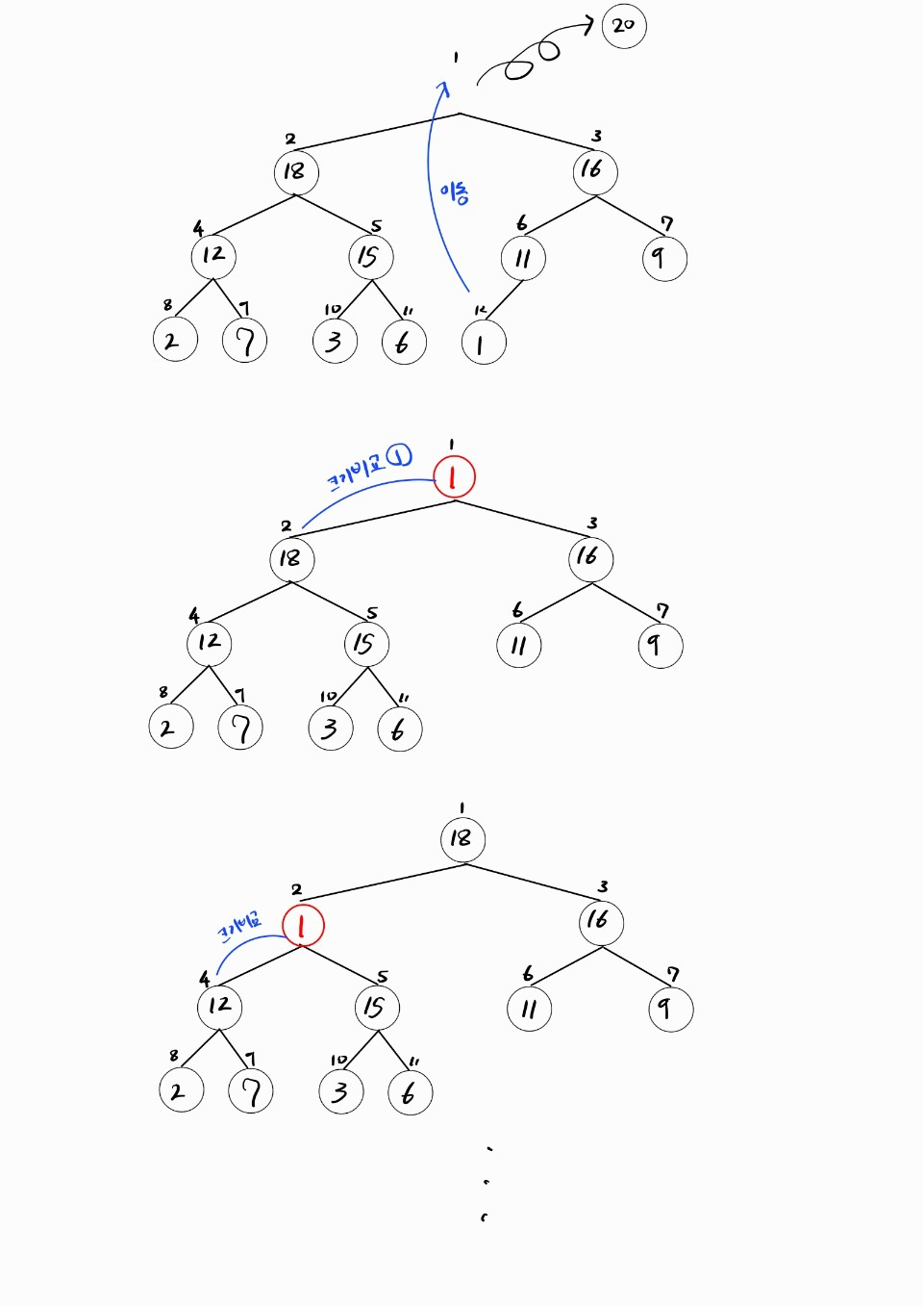
dequeue

Slide 18
dequeue

Slide 19
size <- is size of queue (that point last in array)
heap <- is the array that contains values used in priority queue
Function parent(param index) -> get parent node index of {index}
Function leftChild(param index) -> get left child node index
Function rightChild(param index) -> get right child node index
Function enqueue(param value) ->
heap[size] <- value
size ++
heapifyUp(size – 1) //that maintain heap
Function dequeue() return value ->
root <- heap[0]
heap[0] <- heap[size]
size --
heapifyDown(0) //also, maintain heap
return root
Function swap(param indexFirst, param indexSecond) ->
change location of two node by index parameter.

Slide 20
Function heapifyUp(param index) –>
loop until (index is not 0 AND heap[parent(index)] > heap[index]) ->
swap(index, parent(index))
index = parent(index)
Function heapifyDown(param index) ->
root <- index // root index of subtree
left <- leftChild(index)
right <- rightChild(index)
if(heap[right] < heap[root]) ->
root <- right
if(heap[left] < heap[root]) ->
root <- left
if(root is changed from index) ->
swap(index, root)
heapifyDown(root)

Slide 21
dequeue

Slide 22
Add / remove
Add / remove

Slide 23
deque <- is array that contain value
front <- is index of front
rear <- is index of last
size <- is number of value saved in deque
capacity <- is size of deque, capacity of array to contain
Function addFirst(param value) ->
if(size of deque is 0, front equals -1) ->
front <- 0
else if(index of front is zero, but want to save from front, front equals 0) ->
front <- capacity – 1 //to save value to end of deque array
else(not first add, has field to save before front) ->
front --
deque[front] <- value
size++
Function removeFirst return value ->
value <- deque[front]
initialize deque[front]
if(only one value left in deque, front equals rear) ->
initialize front and rear
else if(front is the last of deque) ->
make front to first of deque
else ->
front ++
size --
return value

Slide 24
문제 1 : https://www.acmicpc.net/problem/28279 //단 직접 구현해 볼 것
문제 2 : https://www.acmicpc.net/problem/18258 //단 직접 구현해 볼 것
문제 3 : https://www.acmicpc.net/problem/2075 //단 직접 구현해 볼 것
-----------------------------------------------------------
과제 문제 1 : https://www.acmicpc.net/problem/1158
과제 문제 2 : https://school.programmers.co.kr/learn/courses/30/lessons/42583
과제 문제 3 : https://school.programmers.co.kr/learn/courses/30/lessons/42586
-----------------------------------------------------------
시도해보기 문제
도전 문제 1 : https://www.acmicpc.net/problem/1715
도전 문제 2 : https://www.acmicpc.net/problem/3190
도전 문제 3 : https://www.acmicpc.net/problem/1766
-----------------------------------------------------------
이것까지? 문제
헬 문제 : https://www.acmicpc.net/problem/11003

Slide 25
THANK YOU

